Slide 1
SQL Project
Work on Employment Details Database
Work by
-Vijay Adithya R S

Slide 2
SQL Basics
SQL Servers
DBMS and RDBMS
Database and Datatypes
MySQL Main Commands
CONTENTS
MySQL General Functions
MySQL Calculate Functions
MySQL String Functions
MySQL Date Functions
Logical Functions
Joins
Procedures and Triggers

Slide 3

SQL
SQL stands for Structured Query Language
Structured query language (SQL) is a programming language for storing and processing information in a relational database.
A relational database stores information in tabular form, with rows and columns representing different data attributes and the various relationships between the data values.

Slide 4
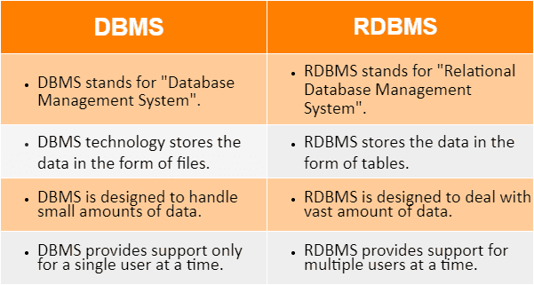
DBMS and RDBMS

Slide 5




Database
A database is a structured way of storing information.
Databases can store large amounts of data, such as credit card transactions, social media clicks, etc.
They can be stored on computers, servers, or in the cloud.
Several companies offer database management platforms designed for efficient data storage and management.

Slide 6
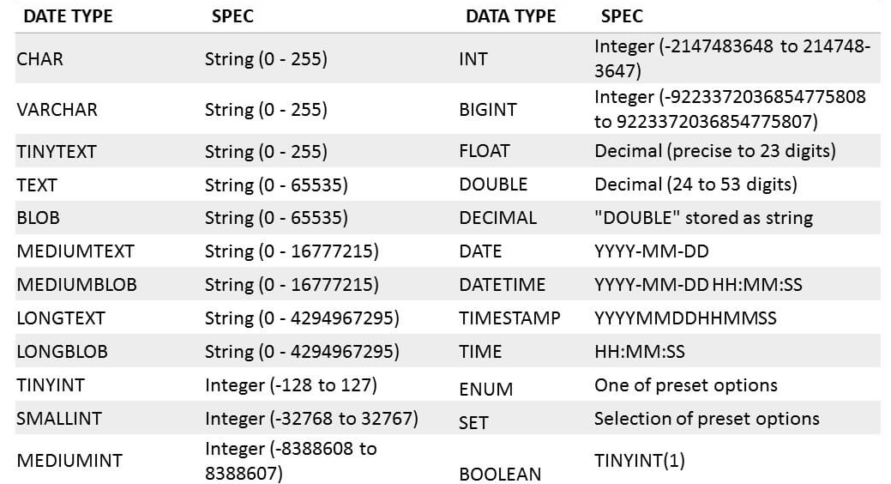
Data Types

Slide 7
MySQL Main Commands
Create Database Query
create database besantproject001;
Use Database Query
use besantproject001;

Slide 8
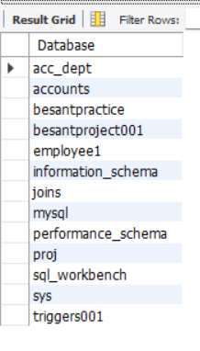
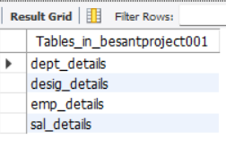
MySQL Main Commands
Show Databases Query
Show Tables Query
show databases;
show tables;

Slide 9
MySQL Main Commands
Drop Database Query
drop database dummy01;
Insert Values into table
insert into emp_details values (17034, 'Vijay', 3003, 50, '2022-08-31');

Slide 10
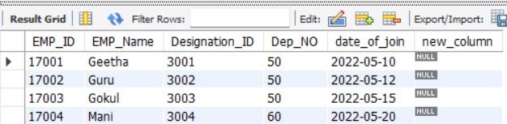
MySQL Main Commands
Drop Table Query
drop table dummy_table;
Alter Table (for new column creation)
alter table emp_details add column new_column varchar(20);

Slide 11
MySQL Main Commands
Alter Table (Modify Column)
alter table emp_details modify new_column int;
Alter Table (drop column)
alter table emp_details drop column new_column;

Slide 12
MySQL Main Commands
Alter Table (Rename Table)
alter table emp_details rename employee_details;
Update Table
update emp_details set emp_name = 'Vijay Adithya' where emp_id = 17034;

Slide 13
MySQL Main Commands
Delete Statement
delete from emp_details where emp_id = 17034;

Slide 14
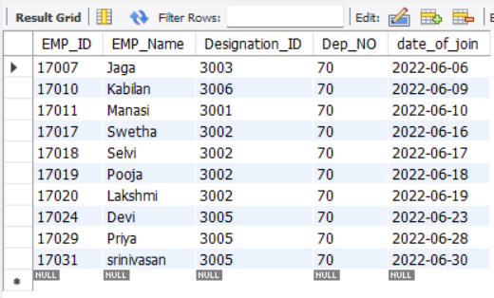
MySQL General Functions
Where Clause
select * from emp_details WHERE dep_no = 70;

Slide 15
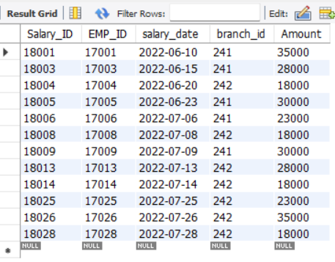
MySQL General Functions
AND and OR keywords
select * from sal_details where (branch_id = 241 or branch_id = 242)and amount >= 15000;

Slide 16
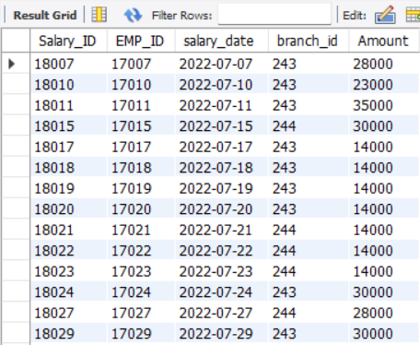
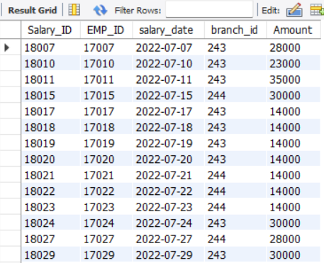
MySQL General Functions
IN and NOT IN keywords
select * from sal_details where branch_id in (243, 244);
select * from sal_details where branch_id not in (241, 242);

Slide 17
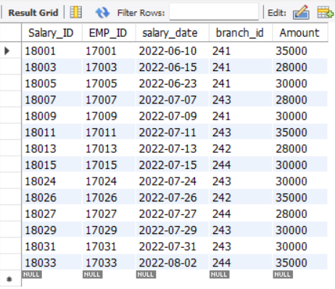
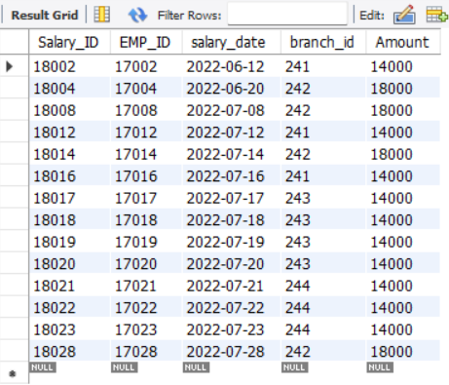
MySQL General Functions
Relational Operators
select * from sal_details where amount >= 25000;
select * from sal_details where amount < 20000;

Slide 18
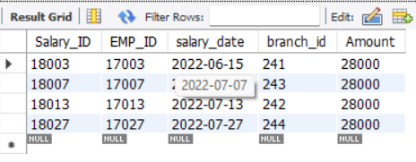
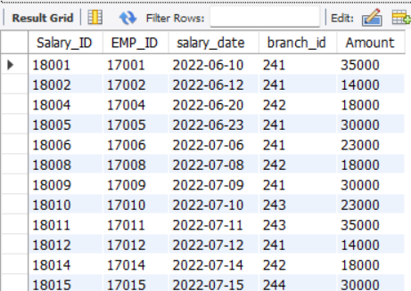
MySQL General Functions
Relational Operators
select * from sal_details where amount = 28000;
select * from sal_details where amount <> 28000;

Slide 19
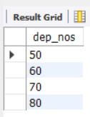

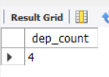
MySQL General Functions
COUNT, DISTINCT, COUNT with DISTINCT
select count(emp_id) as dep_count from emp_details where dep_no = 50;
select distinct(dep_no) as dep_nos from emp_details;
select count(distinct(dep_no)) as dep_count from emp_details;

Slide 20
Add Your Website
Enter title
THANKS
Click here to add content of the text，and briefly explain your point of view
Enter title

